Slide 1

Sharkbanz Case Study and Analysis
Kristy Johnsen, Prince Bhalawat, Gursharan Kaur Saini, and Cornél Hanekom
November, 2021

Slide 2
Table of Contents
Slide 3: The business task
Slide 4: A description of all data sources used
Slide 5: Documentation of any cleaning or manipulation of data
Slide 6: A summary of the analysis
Slide 7: Limitations of the data
Slides 8 - 13: Supporting visualizations and key findings
Slide 14: The top three recommendations based on the analysis
Slide 15: Notes and citations

Slide 3
The business task
Sharkbanz, a world leader in scientifically proven and tested shark repellent technology, has hired our team to analyze the Global Shark Attack Files to see what insights we can gain to help inform their 2022 marketing strategy. Sharkbanz wants to expand its marketing and needs our insights to make data-driven marketing decisions about potential Sharkbanz customers.
What trends do you see with shark attacks? Is there a group that is more at risk?

Slide 4
A description of all data sources used
The data for this case study and analysis is a publicly available data set that was downloaded from the Global Shark Attack File, located here:
https://www.sharkattackfile.net/incidentlog.htm
Ocean temperatures were also explored with this dataset:
http://app01.saeon.ac.za/sadcofunstuff/OceanTemperature.htm

Slide 5
Documentation of any cleaning or manipulation of data
In RStudio, a script was written that performed the following tasks:
Imported the data and created a dataframe
Country, Area, and Location were combined into one column and all rows missing an entry were removed
Created visualizations
In Python, a script was written that performed the following tasks:
Imported the data and created a dataframe
Cleaned the data by removing duplicates and special character cells
Created visualizations
In Excel, the following tasks were performed:
Data was imported
Dates before 1900 were removed
Calculations were performed for standard deviation and average
In Tableau, the following tasks were performed:
Cleaned data was imported
Data was further cleaned to remove null values
Species was filtered to look at only confirmed species identification cases

Slide 6

Summary of the analysis
The average shark attack victim is:
Male
Is an average of 27 years old, and looking at standard deviation we can include ages 14 to 41 in the high risk category
Lives in South Africa, Australia, or the US
Is surfing, swimming, or fishing

Slide 7
Limitations of the data
The dataset does not tell us if the victims were residents or tourists.
Sharks were identified inconsistently, not at all, or possibly incorrectly in many of the reports.
Reports earlier than 1900 were inconsistent with the details of the attack and did not reflect modern-day recreational use.
Many beaches world wide were shut down during the summer of 2020 due to COVID-19 restrictions, which we feel was directly correlated with the decreased numbers of attacks during that year.

Slide 8
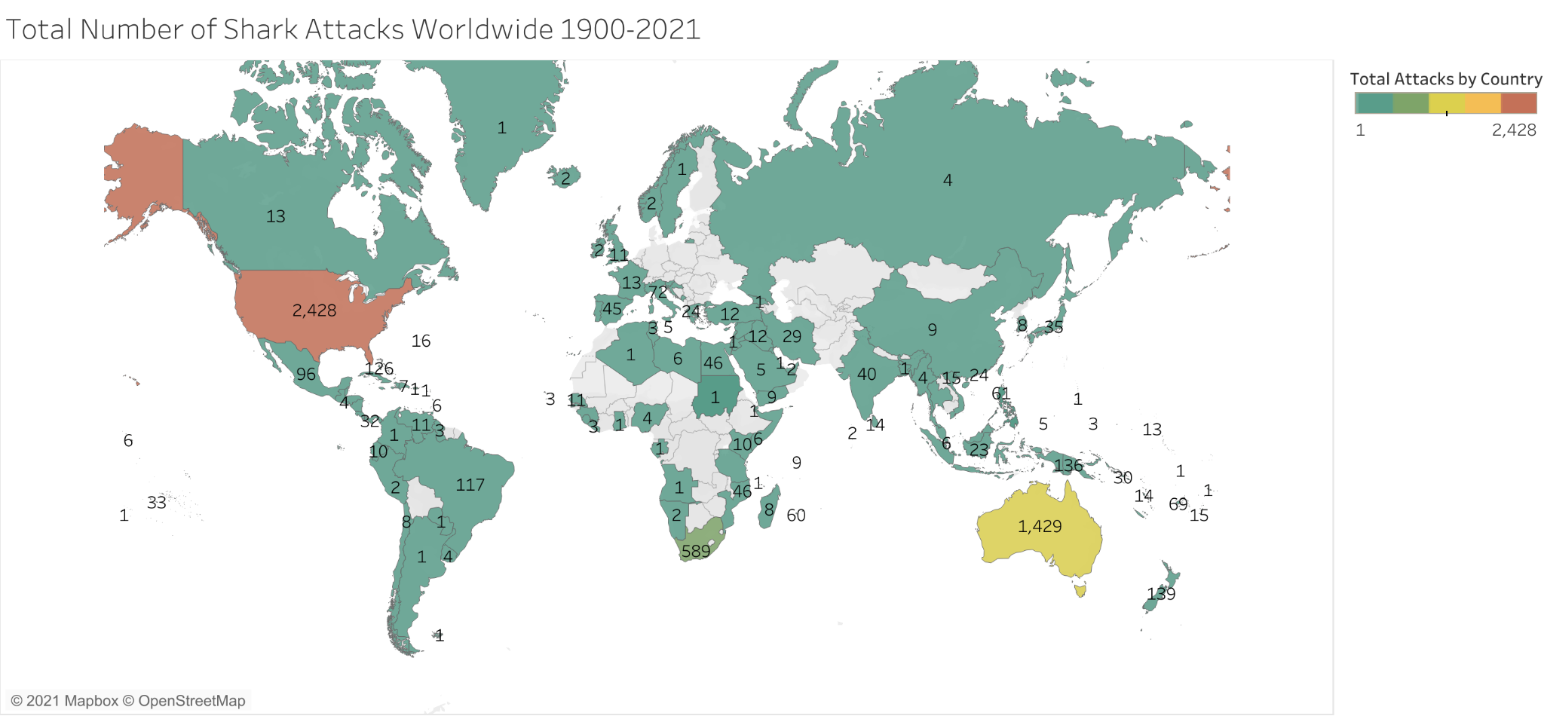
Reported Attacks by Country
The US, Australia, and South Africa have the most reported attacks.

Slide 9
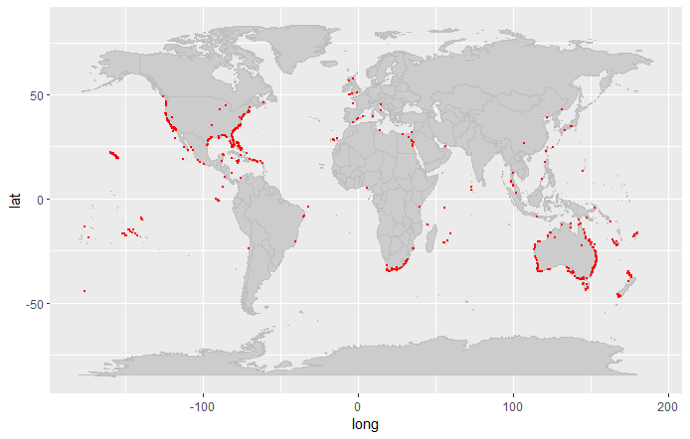
Beach and Recreational Area Attacks
The east and west coast of North America, the east coast of South Africa and the east and west coast of Australia have the greatest reports of attacks.

Slide 10
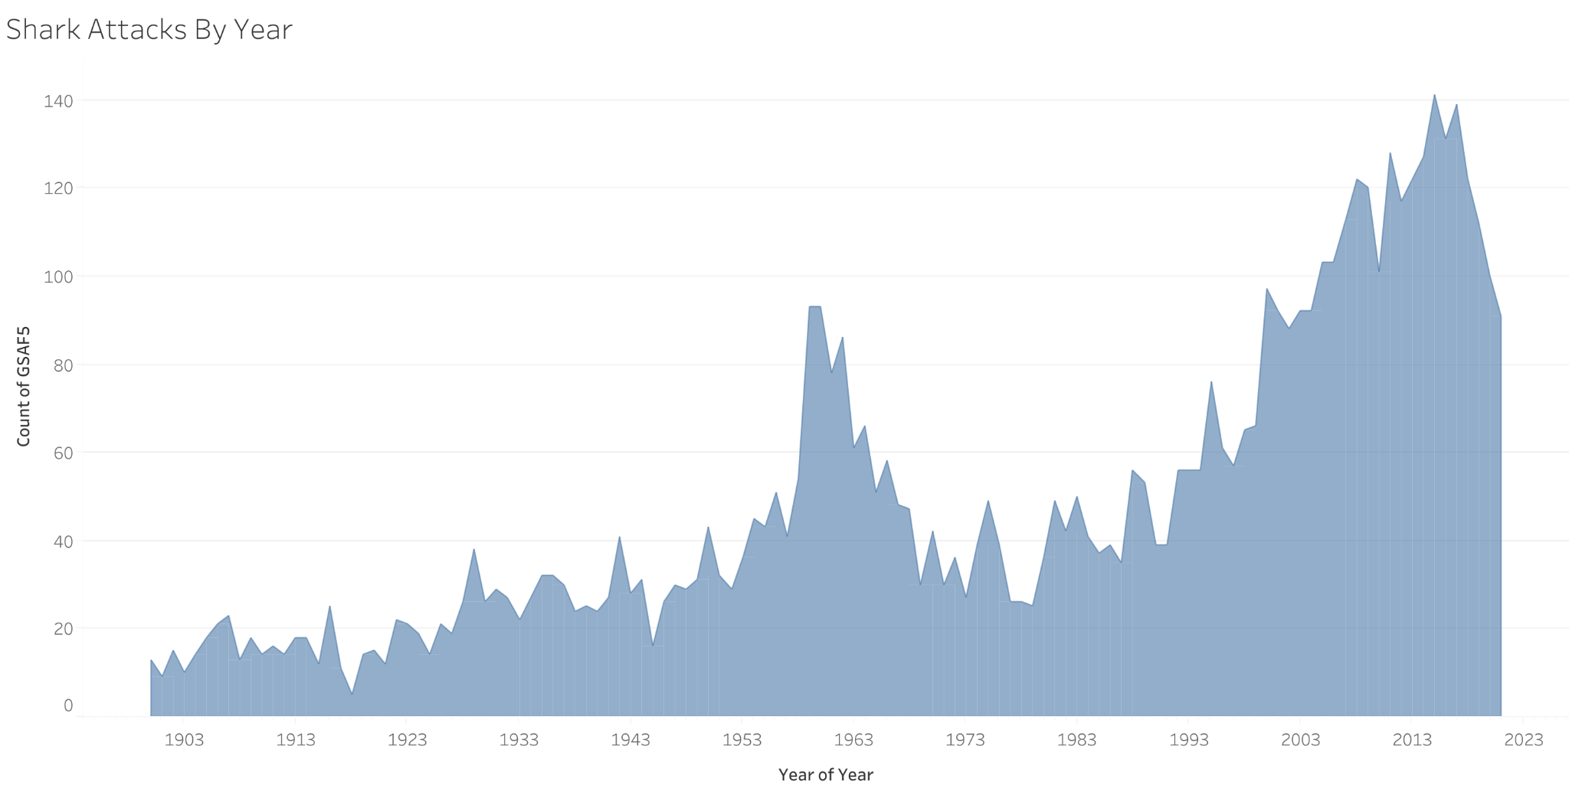
Reported Shark Attacks Since 1900
Shark attacks peaked in the early 1960s and again in 2015.
*Worldwide, many beaches were closed in the summer of 2020

Slide 11
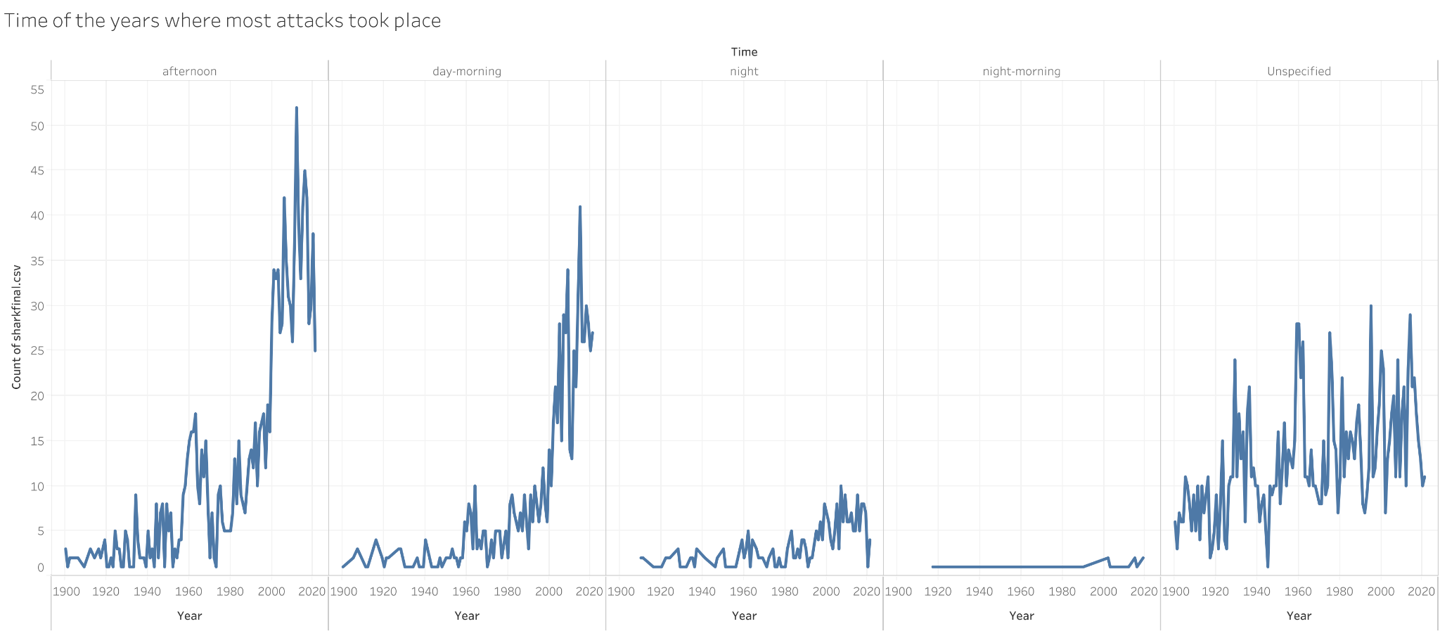
Time of Day
Shark attacks peaked in the morning and afternoon.

Slide 12
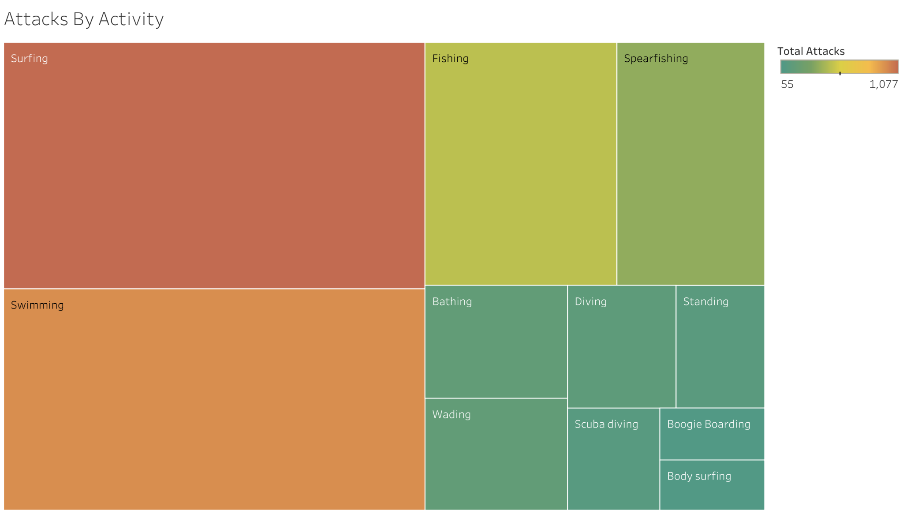
Highest Risk Activities
Surfing, Swimming, and Fishing are the highest risk activities.

Slide 13
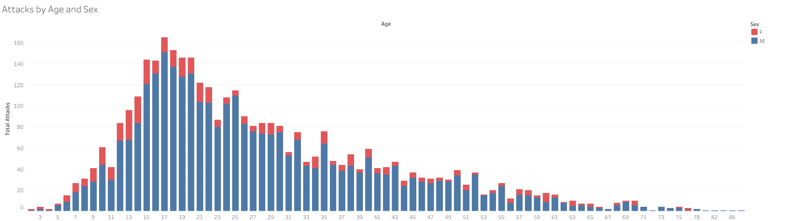
Attacks by Age and Sex of Victim
The average age is 27 years old. The standard deviation is from 14 to 41 years of age. Most are male.

Slide 14
The top three recommendations based on the analysis
Since most shark attack victims are young men who are surfing, swimming, or fishing, marketing strategies should be targeted towards this group. These marketing strategies should include social media and music streaming services to reach this audience. The parents and guardians of the younger members of this cohort should also be targeted, since they are the ones most likely to purchase the Sharkbanz product.
Corporate partnerships should be investigated with national hotels and AirBNB to focus on families traveling to beaches and who may be interested in purchasing or renting Sharkbanz for their vacation. A break down of beaches that have a history of attacks can be found here.
Local retailers can be partnered with to create beach gear rental packages that include Sharkbanz with the rental of a surfboard, boogie board, fishing gear, or other equipment. This will target families visiting the area and looking for package deals to save money.

Slide 15
Notes and citations
This fictional case study was inspired by other case studies in the Google Data Analytics Capstone Project.
Sharkbanz logo is from their company website https://www.sharkbanz.com/
The data source for this fictional case study is from Global Shark Attack File Incident Report https://www.sharkattackfile.net/incidentlog.htm
Clipart is from publicdomainvectors.org
Data cleaning, transformation, calculations, and visualizations in Python by Prince Bhalawat
Data transformation, calculations, and visualizations in Python by Gursharan Kaur Saini.
Data cleaning, transformation, calculations, visualizations, and reports in R and Excel by Cornél Hanekom.
Data cleaning, transformation, calculations, and visualtitions in Sheets and Tableau by Kristy Johnsen.

